Slide 1
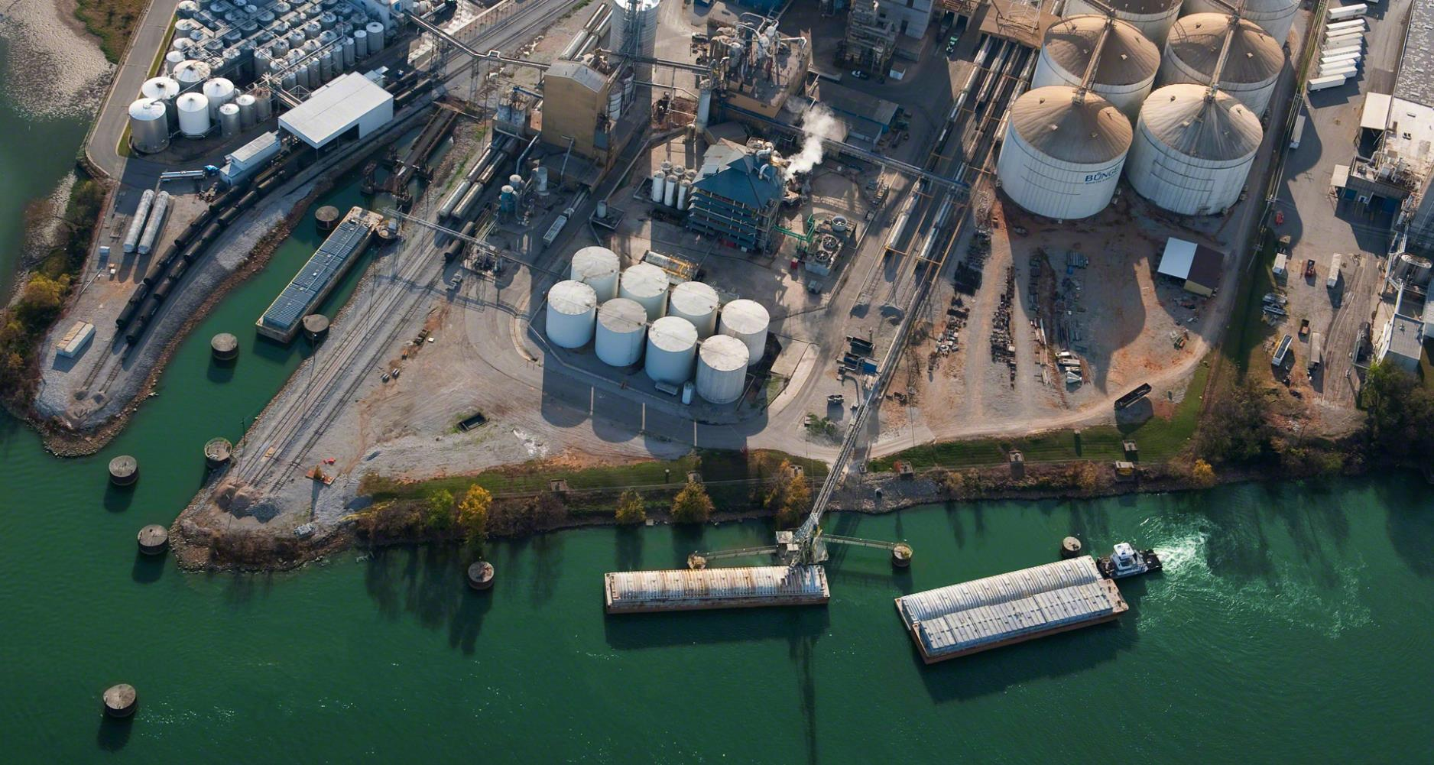
Budowanie odpornosci produkcji w zarzadzaniu projektami – wybrane dobre praktyki
Zapewnienie bezpieczenstwa pracownikow i procesow w czasie projektowania instalacji i prowadzenia projektu
Efektywny proces zarzadzania projektami gwarantujacy realizacje projektow zgodnie z zakresem, budzetem i harmonogramem
Na co zwaracac uwage by wdrazane projekty dodawaly wartosci produkcji i wspieraly realizacje celow organizacji
Slawomir Kluszczynski
NCE Market Projects Lead

Slide 2
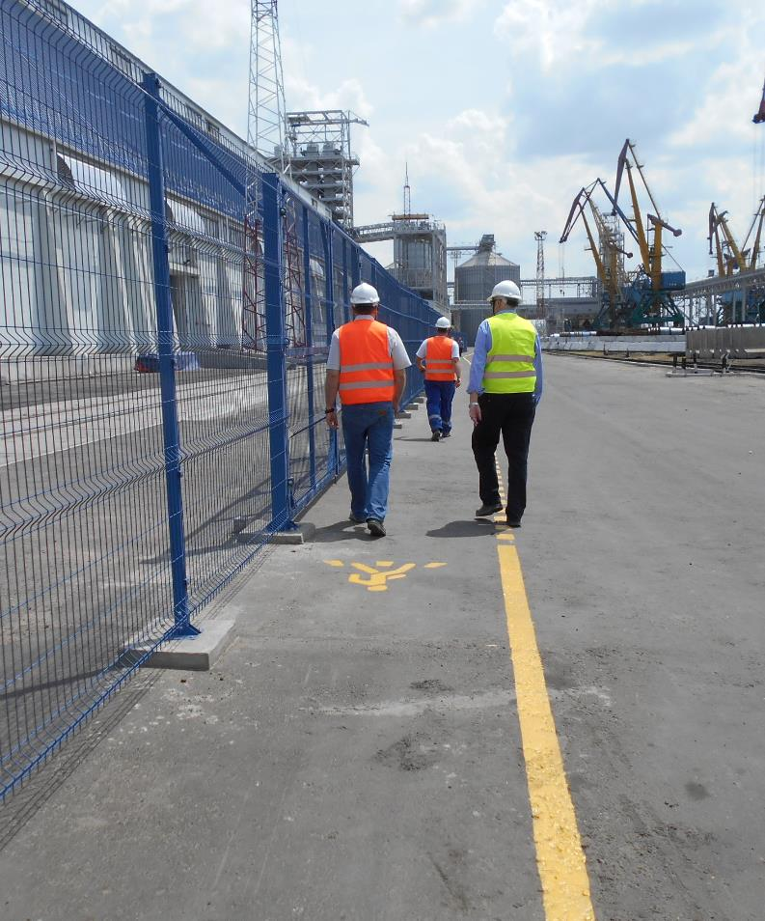
Bunge at Glance | Bunge Globally Bunge in Poland
Guess... | …. ?
Safety Aspects in Projects | Safety Tip Safety First Safety Project Tools and Processes Pre-Start up Safety Review
Efficient Projects Management | Stage Gate Process for Major Projects Projects Governance Structures Risks Mitigations Legal Aspects
What should be focus in order projects add value to the organisation | Discipline Monitoring Progress & Escalations Vendors Strive for Continuous Improvement Awards
Agenda

Slide 3




Bunge at a Glance
Bunge is a key part of the global food system
23K+
Employees
300+
Facilities
40+
Countries
60 Bn USD Net Rev
We are the world’s leader in oilseed processing and
a leading producer and supplier of specialty plant-based
oils, fats and protein.
We supply high-quality commodity products around the world, transform and collaborate with our customers to develop tailored solutions and unlock the full potential of plant-based oils and fats and milled products to meet evolving dietary needs and trends.
We have more than two centuries of experience,
unmatched global scale and deeply rooted
relationships everywhere we operate.
Our products are used in a wide range of applications, such as animal feed, cooking oils and flours, as well as bakery and confectionery, dairy fat alternatives, plant-based meat and infant nutrition. Bunge also has an important role to play in using our crop infrastructure to help fuel renewable energy solutions.
Notes:
Speaker notes:
Bunge is a company that matters in an industry that matters and will continue to be vitally important as demand for food grows.
With more than 200 years of experience, our more than 23,000 employees work to put quality food on the table, increase sustainability where we operate, strengthen global food security, and help communities prosper. We bring products from where they’re grown, to where they’re processed, and to where they’re consumed.
We value our partnerships with farmers to help discover new markets for their products and to improve the productivity and environmental efficiency of agriculture. From them, we source oilseeds, grains, softseeds and tropical oils and then we store, transport, process and refine it all at our facilities located in more than 40 countries.
At the same time, we collaborate with our customers to create and reimagine the future of food, developing tailored and innovative solutions to meet evolving dietary needs and trends, delivering the functionality the food and nutrition industry demands, and satisfying the diverse tastes of consumers in every part of the world.
We have strategic and reliable decision-making processes that rely on the insights we learn from our global presence. We are able to identify shifts and risks in the global food industry, anticipate consumer choices, trends and needs, and help our customers adapt to these changes quickly. We manage production, distribution flows, quality and risk and provide transparency across fully integrated end-to-end value chains.

Slide 4
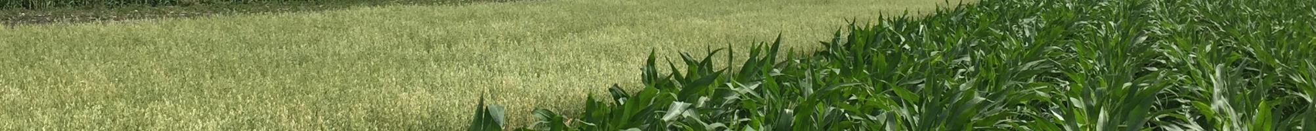
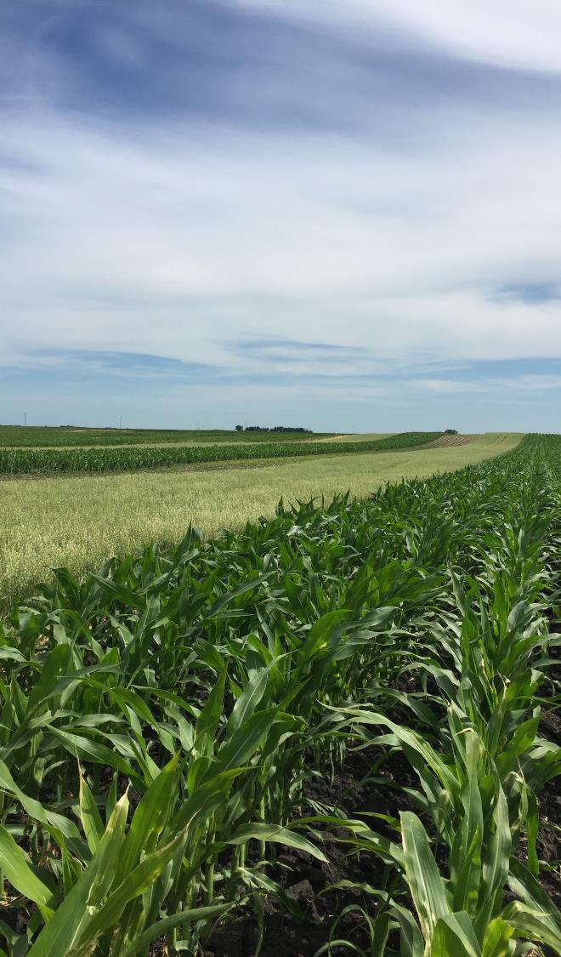




Unmatched Global Oilseeds Footprint
80+
Grain
Elevators
51
Oilseed Processing Plants
Bunge is the global #1 in crush volume capacity
Europe
28
Port
Terminals
North America
Asia
42
Oil
Refineries
South America
Soy crush
Soft crush
Multi crush
34
Packaging
Sites
Palm refinery
Notes:
Speaker notes:
We have the best global oilseeds platform in the business, an incredible team, and the leading market position.
Our global network of facilities spans six continents and includes grain elevators, oilseed processing plants and strategically located port terminals.
We process soy, the full range of soft oils: canola, rapeseed and sunseed and tropical oils including palm and shea. These oils provide the feedstock for our downstream edible oils refineries, blending and packaging facilities.
From our headquarter located in St. Louis, Missouri, we have a tightly integrated network of assets combining oilseed processing plants, grain facilities, and food and ingredient production and packaging facilities around the world. We support these with 30 port terminals, more than 100 grain elevators and over 200 chartered ocean vessels, providing Bunge unmatched flexibility to be able to adjust quickly to customer needs and changing market conditions.

Slide 5



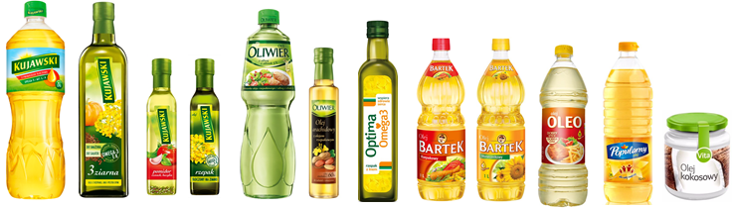
Bunge in Poland
1000+
Employees
OUR OILSEEDS
Bunge is the largest oilseed processor and producer of vegetable fats in Poland and one of the largest in Central Europe.
We supply a diversified offer to the agri-food market. We specialize in the production of bottled oils, consumer margarines, professional fats for bakery and confectionery industry as well as crude oil products for the biofuel and rapeseed meal for the feed industry.
3 Production facilities
1 Port terminal
Soybeans
Sunflower
Rapeseed
OUR PRODUCTS
+70 Years of experience
in Poland
Meal
Vegetable oil
Fats
Every second bottle of oil on the Polish market comes from our plants
import and distribution of soybean meal
export of grains
s
# 1 in bottled oils, professional margarines and bulk oils in Poland

Slide 6
Guess….
What is the most popular Vegetable Oil type?

Slide 7
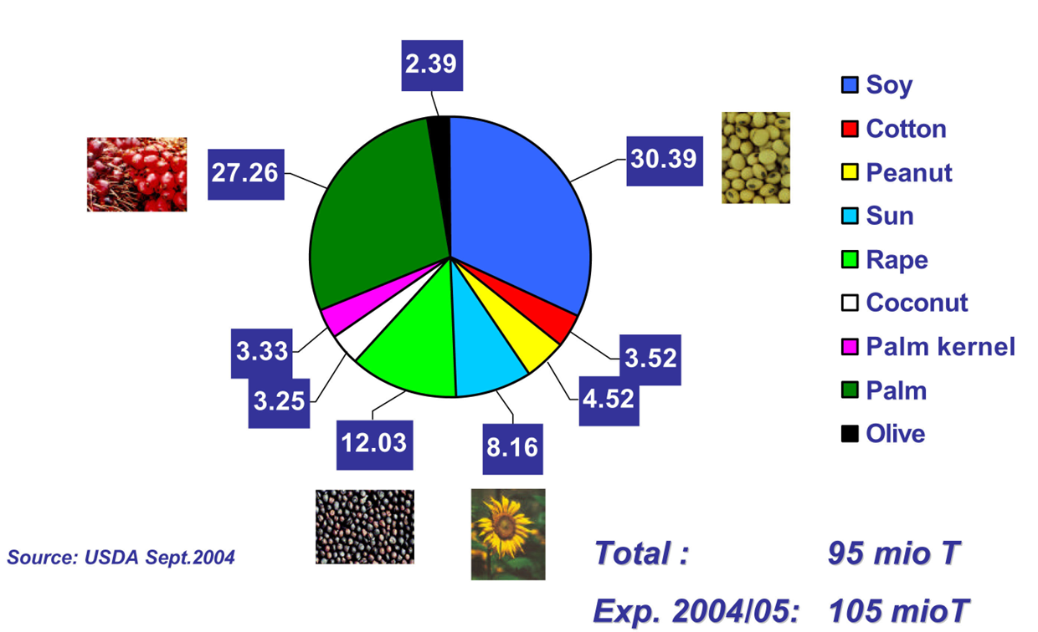
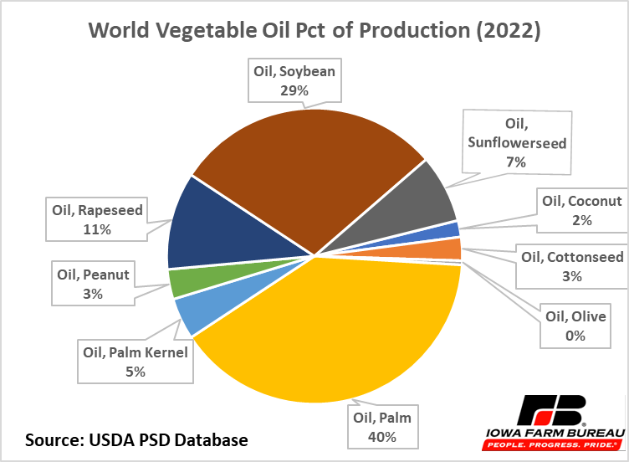
What is the most popular Vegetable Oil type ?

Slide 8
Safety Aspects in Projects
Chosen Practices Supporting Production Safety

Slide 9








Commitment to a Safety Culture
Our relentless pursuit of safety is rooted in our care and concern for people and their families.
The safety of our team and the communities in which we operate comes first.
We envision an organization where no one gets hurt — one that keeps us competitive and ensures we can meet our commitments to employees, their families and our customers around the world.
Investments in technology to transform how we operate,
to enhance efficiency and improve how we interact with farmers and customers.
Focus on incident prevention through safety leadership
at all levels, front-line engagement and active recognition and control of seven high-potential exposures.
Mobile Equipment
Hoisted Loads
Work at Height
Process Safety
Avoiding risks:
Confined Spaces
Hazardous Energy
Hazardous Chemicals
Notes:
Speaker notes:
The safety and well-being of our more than 23,000 dedicated employees is a critical priority at Bunge.
We continue to make significant investments in technology to transform how we operate, to enhance efficiency and improve how we interact with farmers and customers.
We focus on incident prevention through safety leadership at all levels, front-line engagement and active recognition and control of seven high potential exposures.

Slide 10

SAFETY TIP

Slide 11
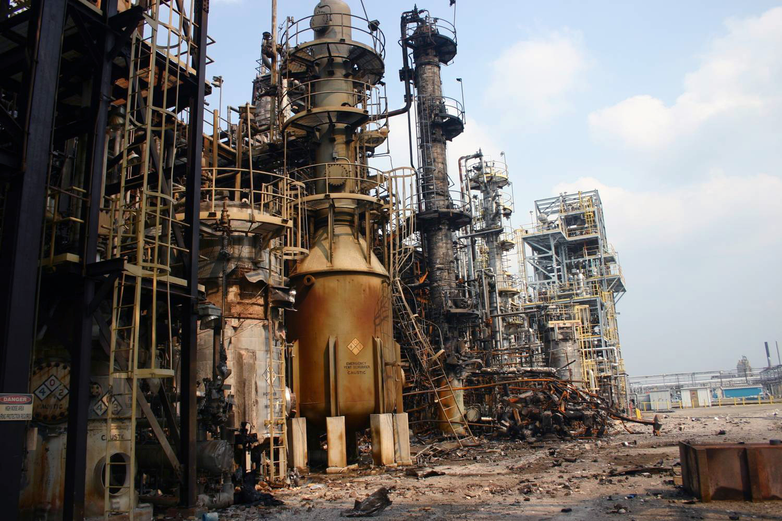
In this incident two people were killed and eight injured.
WHAT DO YOU SEE ON THE SCREEN?
GUESS WHY IT HAPPENED?

Slide 12
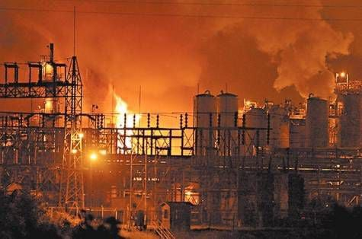
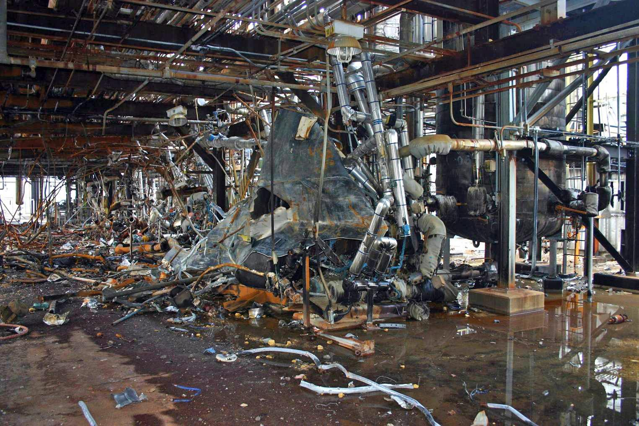
PESTICIDE CHEMICAL RUNAWAY REACTION (WEST VIRGINIA) 2008
The subsequent investigation by the US Chemical Safety Board concluded that, although a PSSR had been carried out, it was inadequate, and that this was a significant contributing factor in the incident.
Deficiencies which should have been identified and corrected by application of PSSR, each of which contributed to the extent of the disaster, included:
New equipment was not tested and calibrated before startup.
Inadequate training to operate the new unit and its distributed control system (DCS).
Malfunctioning equipment and inadequate checking of DCS operation and displays.
Standard operating practices not revised to address information specific to the new control system.
Lack of sufficient technical coverage to support the startup.

Slide 13
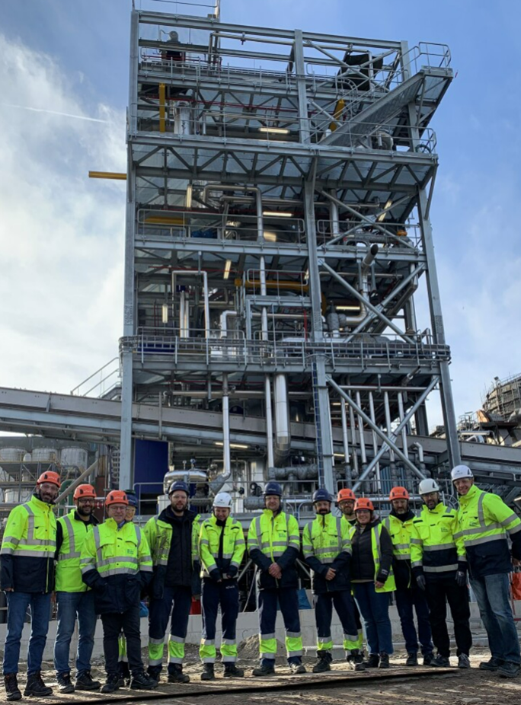








Safety First !
Safety is our Culture
We award operators that stop operations in case of safety risk of people, products, processes or environment
We design installations in our projects with highest safety standards
We involve experienced experts at every stage of the project in order to design our installations safely
Safety is every employee responsibility and our daily teamwork focus
Projects are measured with safety KPIs
What are the improvement points at construction safety for you/your project ?
13

Slide 14
Safety Considerations – Project Example
EHS & Food Safety; Fire Protection; Process Safety Management; Material Handling & Storage
New seed pre-cleaning have solid waste generation: cc. 48 mt/day
Increase the hexane extraction process area (ATEX) with 100 m2
Supplier 1 hulls boiler requires independent fire pump, and it will have challenging dust emission(5 mg/m3)
Supplier 1 boiler has narrow range of capacity to be regulated: between 60%-100%
New Plant must be built as Food Ingredients facility: GMP as important as in Lecithin dryer
Dehulled kernel storage and handling must be as gentle as possible
Storage of dehulled kernel is more challenging as seeds storage (quality degradation, insect appealing)
The construction will be happening also while facility continue to operate, the first constructability review will be done on phase 2
Work at height during construction and access to platform at Hight must be accessible with stairs i.o. ladder
14
Notes:
Health and Safety issues
EHS reviews required
Food safety assessment

Slide 15
How to Ensure Final Product Compliance / Engage Owners
Total Safety Statement of Compliance in Projects Mgt
Project Title and Number
People & Asset Safety | Name of Local People & Asset Safety Manager | Initials | Date
A risk assessment considering the impact the new project has on People & Asset Safety has been completed and included in the project documentation. The risk assessment and appropriate measures in order to handle and/or mitigate risk has been discussed and agreed with local People & Asset Safety Management/TS-Management and recorded in writing. People & Asset Safety regulatory aspects (European and local ones) are being considered as part of the project. The project will comply with the respective Bunge standards Based on the overall level of the People & Assets Safety risk assessment, involvement of the Area TS-Manager in this project is / is not required.
Product & Logistic Safety | Name of Local Product & Logistic Safety Manager | Initials | Date
A risk assessment considering the impact the new project has on Product & Logistic Safety has been completed and included in the project documentation. The risk assessment and appropriate measures in order to handle and/or mitigate risk has been discussed and agreed with local Product & Logistic Safety Management/TS-Management/Quality Assurance Management and recorded in writing. Product & Logistic Safety regulatory aspects (European and local ones) are being considered as part of the project. The project will comply with the respective Bunge standards. Based on the overall level of the Product & Logistics Safety risk assessment, involvement of the Area TS-Manager in this project is / is not required.
Environmental Safety | Name of Local Environment Safety Manager | Initials | Date
A risk assessment considering the impact the new project has on Environmental Safety has been completed and included in the project documentation. The risk assessment and appropriate measures in order to handle and/or mitigate risk has been discussed and agreed with local Environmental Safety Management/TS-Management and recorded in writing. Environmental Safety regulatory aspects (European and local ones) are being considered as part of the project. The project will comply with the respective Bunge standards. Based on the overall level of the Environmental Safety risk assessment, involvement of the Area TS-Manager in this project is / is not required.
Plant Safety | Name of Plant Manager | Initials | Date

Slide 16
Elements of Process Safety
Employee Participation
Process Safety Information
Process Hazard Analysis (PHA)
Operating Procedures
Training
Mechanical Integrity
Management of Change
Contactors
Pre-Start Up Safety Review
Incident Investigation
Emergency

Slide 17
PSSR (Pre-Start up Safety Review)
OPERATIONAL READINESS
PSSR is a systematic process that evaluates the safety aspects of a new or modified facility before it becomes operational. The primary purpose is to ensure that the startup process is executed safely, minimizing the risk of accidents or incidents.

Slide 18


PSSR – The flow
Assignment of PSSR leader & team
Communicate the scope at PSSR TEAM
Define the Agenda of PSSR
1 – Does not impact security, but needs to be resolved after start up;
2 – It has an impact on safety, it needs to be addressed before and resolved after Start up;
3 – Impacts on safety and needs to be resolved before Start - up
Preliminary meeting remote with both, Plant and PSSR team
Planning of PSSR
Distribution of inspectors
Open Action
Field visit
Planing of Actions and responsible person
Meeting wit PSSR team
Final evaluation and distribution
Closing of impeditive ones. Green light to run
Punch list with photo
Execution
Action plan
Closing and approval

Slide 19
ASSIGNING PSSR LEADER & PSSR TEAM
PSSR Team: is a group of Bunge Employees Multidisciplinary experts in their professional field
PSSR Leader: Component of PSSR team responsible for organize the PSSR team and conduct the inspection on field with focus on the project and his scope. A PSSR leader is always a Bunge employees with experience in our operation and preferably must be from the plant out side of Project executed.

Slide 20
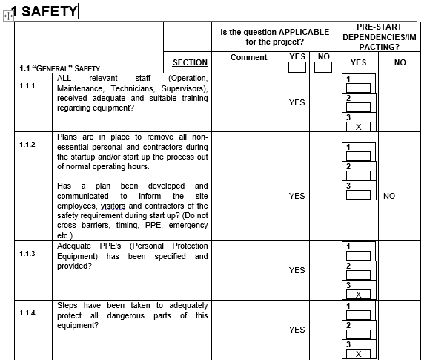
PSSR – Check list
Points that are reviewed during the PSSR are the following:
  1 SAFETY
  1.1 General Safety
  1.2 Machinery Safety
  1.3 Ergonomics
  1.4 Occupational Health
  1.5 Electrical Safety
  1.6 Fire Protection
  2 PROCESS SAFETY MANAGEMENT (PSM)
  2.1 Process Technologies
  2.2 Technology Change Management
  2.3 Process Risk Analysis (PHA)
  2.4 Quality Assurance
  2.5 Mechanical Health
  2.6 Operational Procedures & Safe Practices
  2.7 Training
  2.8 Contractors
  2.9 Interlocks & Alarms
  3 ENVIRONMENT
1 - No impact on Safety, but needs to be resolved after the start-up;
2 - Impact on safety, must be resolved contingent before and after start-up;
3 - Impact on safety and need to be resolved before the start-up;
When the plant will close the open point, 1, 2 or 3 will report DONE in the column “NO” under section PRE-START DEPENDENCIES/IMPACTING.

Slide 21
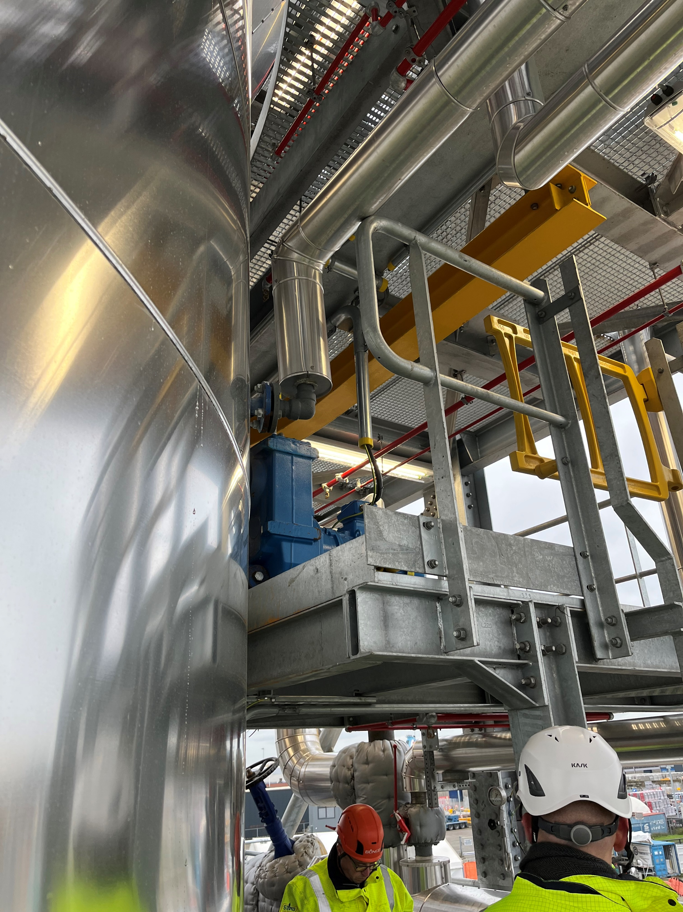
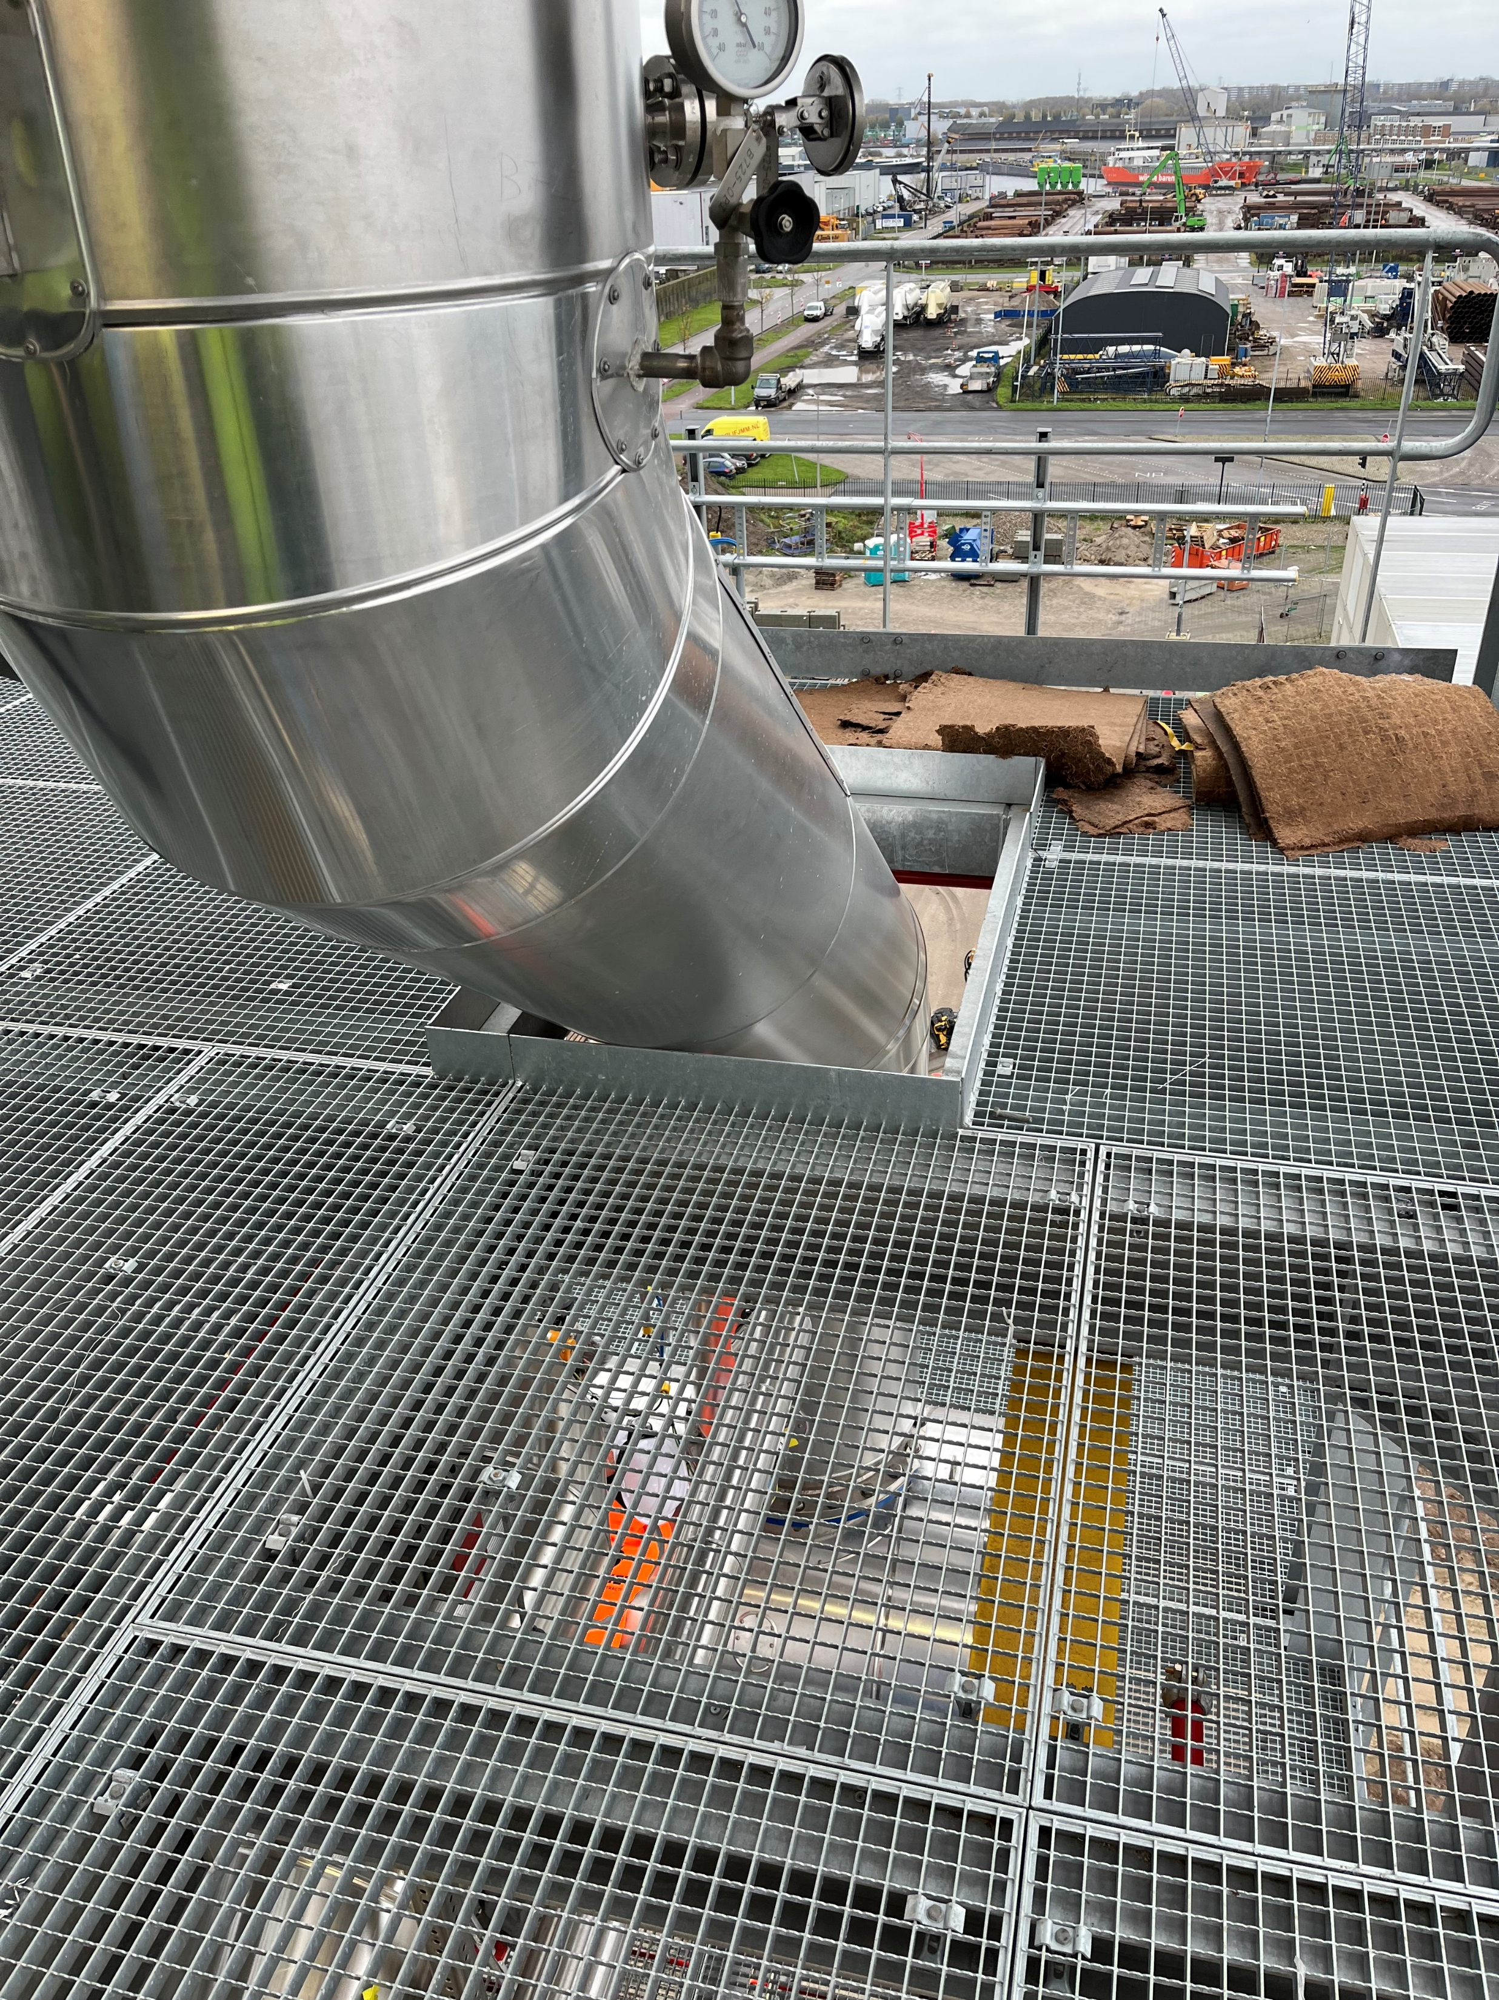
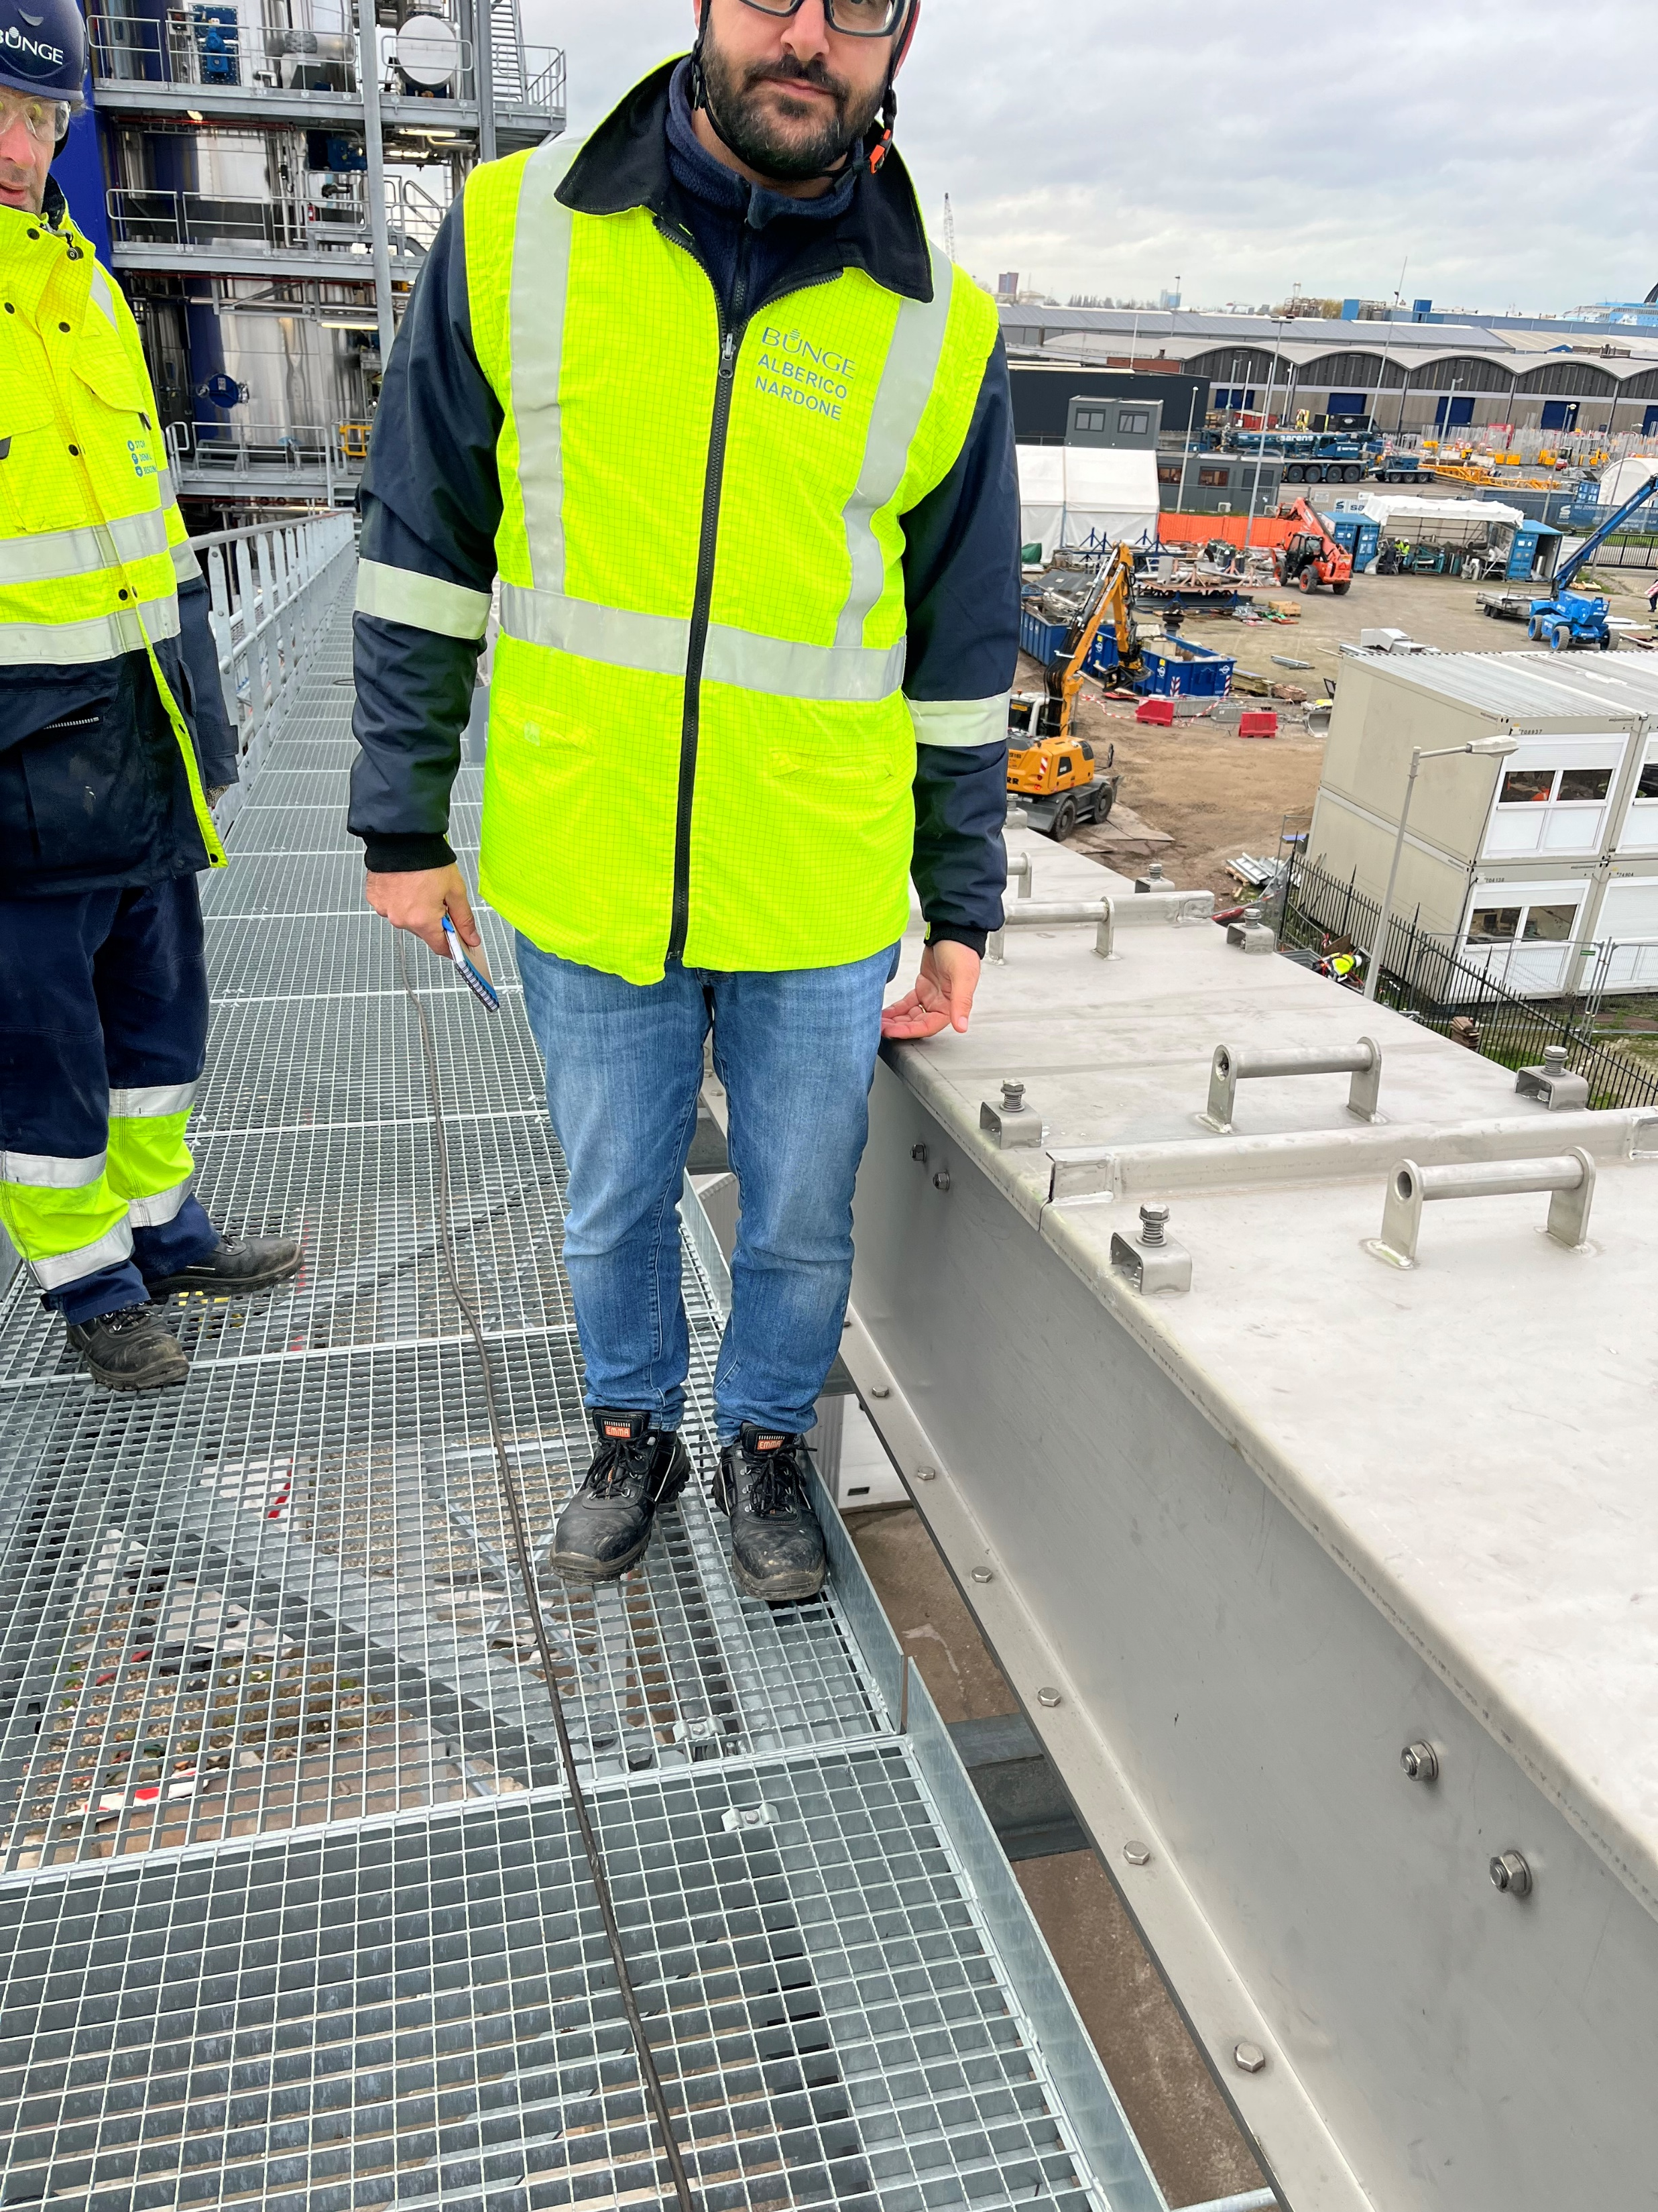
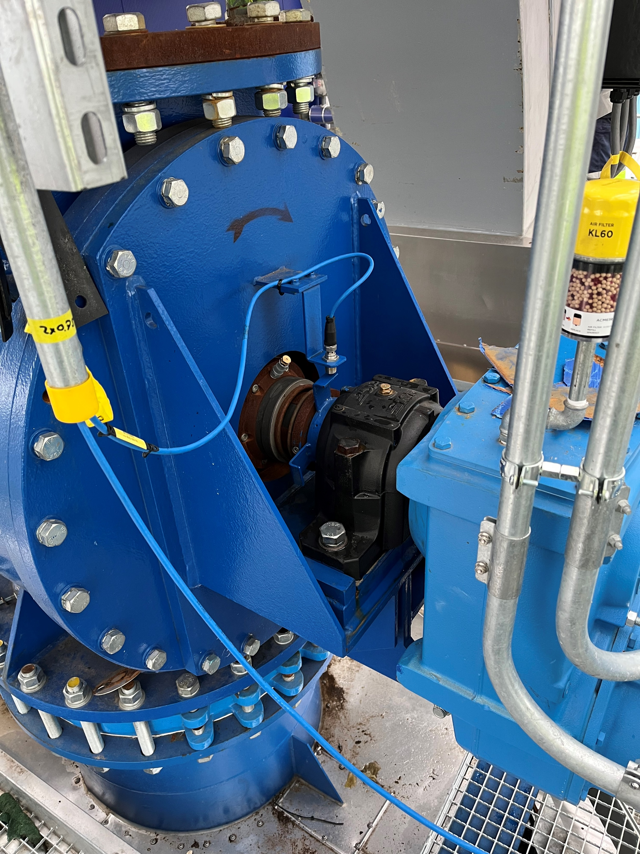
Example of level 1, 2 or 3
Level 1
Level 2
Level 2
Level 3
Mark the lifting beams
Protection the distance between piping and floor
Protection for the body (tempory with life line)
Protection rotating part

Slide 22
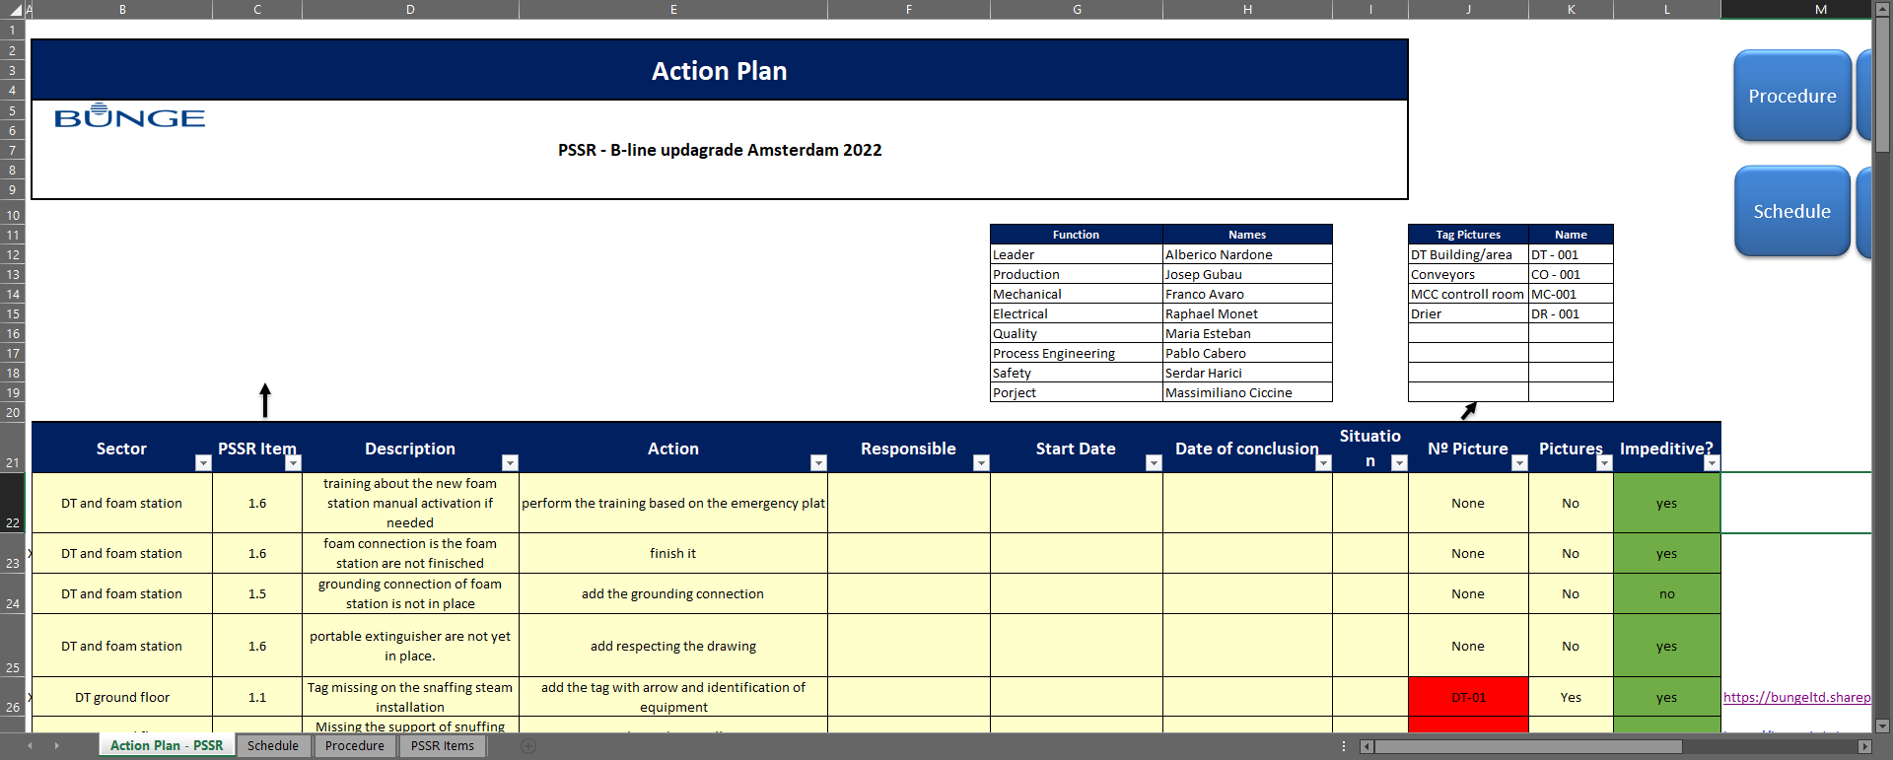
PSSR – Punch list

Slide 23
Efficient Projects Management
Chosen Practices increasing Production Resiliency

Slide 24
What is the Project ?

Slide 25
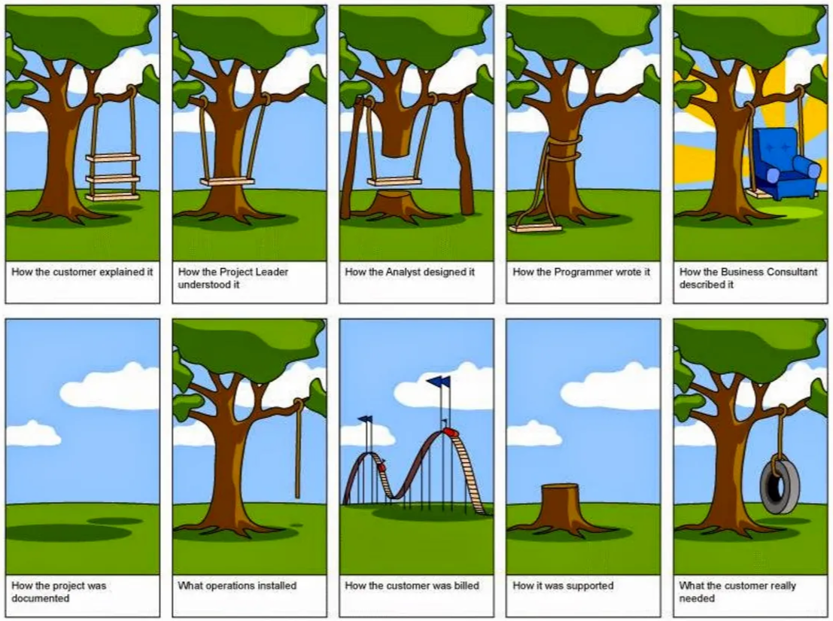
What is the Project ?
Performed by people
Constrained by limited resources
Planned, executed and controlled

Slide 26

 |  The Major Capital Project Planning Policy 
Phase | Phase | Phase | Phase | Phase
Business Case | Scope Definition | Project Definition | Project Execution | Operation & Evaluation
MAJOR DELIVERABLES
Approve Business Case and authorize appropriate funding for Phase II, including basic engineering | Approve frozen scope and authorize appropriate funding for Phase III, including preliminary detailed engineering | Approve Preliminary detailed engineering and authorize submission of project application | Approve project completion and authorize plant operation | Approve project closeout and plant performance
Cost: 1 to 5 Percent of Total Installation Cost cumulative through Phase 3 |  |  | * Refer to Section 4 – Part F for Minimum Mandatory Requirements
1
2
3
4
5
Project Stage Gates
Mgt. Process
Project Charter
Steering Committee
SHE and Legal Assessments
High Level Risk Analysis
Conceptual Engineering
Preliminary Cost Estimate
(level of confidence -25%/+40%)
GIO Review if applicable *
Review by CapEx Projects Committee for projects greater than $50M
Schedule and Resources for
Phase 2 Activities
Other Deliverables as appropriate
Refine Project Charter
Preliminary Project Application
Evaluation of Alternatives
Select Final Location
Define Core Technology
Frozen Commercial Scope Definition
SHE Strategy
Refine Risk Analysis
Basic Engineering
Insurance Provider Review
Major Package TCO List
GIO Review if Applicable *
Preliminary Contract Execution Approach
Cost Estimate (level of confidence -15%/+25%)
Schedule and Resources for Phase 3 Activities
Other Deliverables as Appropriate
Refine Project Charter
Refine Project Application
Preliminary Detailed Engineering
Final Contracting Approach
Bidding Packages for Long-Lead Equipment Acquisition
Preliminary Start-up and Commissioning Plan
Final Schedule
Final GIO Review if Applicable *
Attach Form 7
HAZOP / HAZAN
Final SHE Plans including Sustainability for Construction and Operation
Final Risk Assessment
Insurance Provider Review
Cost Estimate (level of confidence -10%/+10%)
TCO Preliminary Models
Other Deliverables as Appropriate
Select Final Project Execution Team
Finalize Detailed Engineering, Incorporating Global Industrial Standards
Complete Bidding for Equipment and Contracts
Final TCO Models
Finalize Purchasing
Award Contracts
Perform Project Controls Including Safety, Contract Management, Budget and Scope
Perform Execution Inspections and Physical Progressing
Insurance Provider Review
Payment Management
Complete All Construction
Finalize Start-up and Commissioning
Confirm Operational Safety Systems
Plant Start-up and Achievement of Steady Operation
Acceptance by Operations
Confirm Accomplishment of Operational Objectives
Project Management Assessment
Determine What Went Well and What Needs Improvement
Overall Safety Evaluation – Engineering, Construction, Start-up and Operations
Share Lessons Learned
Improve Company Work Process
Recycle for greater definition
Recycle for greater definition
Recycle for greater definition
Stage compulsory delivery items
Proceed to the next stage
Stage compulsory delivery items
Proceed to the next stage
Stage compulsory delivery items
Proceed to the next stage
Gate Review
1
STOP
Gate Review
2
STOP
Gate Review
3
STOP
Acceptance
4
Closeout
5
Cancel or File
Cancel or File
Cancel or File

Slide 27
Bunge Project Management Fundamentals
Major Capital Projects Planning Policy (MCPPP)
Capital Investments Policy
Global Purchasing Policy
Bunge Global Projects Management (BGPM)
Assets Care Standards
User Guide For TCO Process
Global Engineering Standards

Slide 28
Preliminary project governance
Design Phase
Bunge
Steering Committee
Authorities
Bunge
Project Management Team
Permitting Lawyer (traffic, noise, emissions, waste)
Engineering:
Mechanical
Civil
E&I
Utilities
Engineering Company
Crushing
Boiler
Refinery
Process Technology suppliers
Process & equipment data:
PFD, PID & Mass Balance
Instrumentation data
Process performance warranties
Equipment data (load, power, dimensions)
Supplier 1
Supplier 2
Supplier 3

Slide 29
Project Organization Chart
Phase 2,3,4,5
Chairperson
Value Chain Finance Lead
Region Procur. Director
Bussiness Development
Plant Manager
Color Legend
Steering Committee
Market Indust. Director
Market Project Lead
Environmental Director
BEA Capex Manager
Bunge Employee Full Time on Project
Sponsor
Region Project. Director
Region Safety Director
Sunseed VC Director
Associate General Councel
Bunge Employee Part Time on Project
Market Project Lead
Eng/PM Manager
Eng/PM Manager
Engineering Partner Comapny
Project Manager
Project Manager
Engineering Partner
Corporate
Support
Plant Manager
CSA Manager
Enginnering Partner
Safety Coordinator
Environmental Lead
Procurement Abroad Contract
Business & Finance Lead
Project Administration
Proccess / Raffinery
Process Engineer
Eng Partner
Project Safety Administrator
Project Environmental Administrator
Procurement Local
Project Budget Control
Maintenance /Reliability
Proccess / Crush
Other Eng
Eng Partner
Procurement Support
Quality & Food Safety
Electrical, Utility Energy & Water Treatment
BEVC
BEVC
BEVC
COE Process
COE Process

Slide 30
Why the Project
Prepare Business Case & Commercial Assumptions
Project Rationale Examples
Innovation : to be in the market forefront with the new technology and secure competitive advantage in the growing segment,
Growth : identified and confirmed with customers growing demand in given market segment eg: for sustainable, non-GMO, non-allergic, short supply chain products,
Capacity : should be ready for the rapid company growth and unexpected demand peaks
Existing Supply Chain advantage : close to main markets for demanded products, wide and agile distribution
Economy of scale : As an oilseed, can be scaled up to make an impact,
Market opportunities : potential for product premiumusation vs other alternatives,
Key competitors analysis : indicates our success high probability
Additional savings : eg. environmental waste reduction will be the project asset and can mitigate / cover project risk failure
Other : important to deliver company startegy and vision, differentiate or strenghten the brand
30
Notes:
Clearly framed business opportunity,
Detailed discussion of the business needs the project is intended to address
Customer input
Market Research
Competitive Studies
Industry norms
Identified business alternatives
Target locations
Evaluation of effects on existing and future businesses
How does it fit into strategic plan?

Slide 31
Mitigate Main Risks
Identified Risks
Mitigation Actions
BUSINESS / EXTERNAL
Sunfower Seed Origination
Demand for Sun Protein Concentrate
Energy Price
Alternative sources of supply
Develop market
Prepare alternatives
TECHNICAL /
QUALITY
Protein Technology Parametrs
Quantity of Supplied Sunflower Seeds
Quality/Size of Supplied Sunflower Seeds
Dehulled seeds Storate for Protein for 2-3 weeks
Design and Test with Crown
Aqua/Etenaol extraction de-watering
The vacuum dryer design
Z type conveyor whole kernel and bypass to conventional process in case of heating up
ORGANIZATIONAL
Lack of Resources
Brownfield continuosly operating
Provide Resources for Each Phase
Prepare Safety and Project Logistics
MANAGEMENT
Lack of Permit
Project delay due to Permit Delay
Legal support and management upfront
Continuous Close Relation with Offices
31

Slide 32
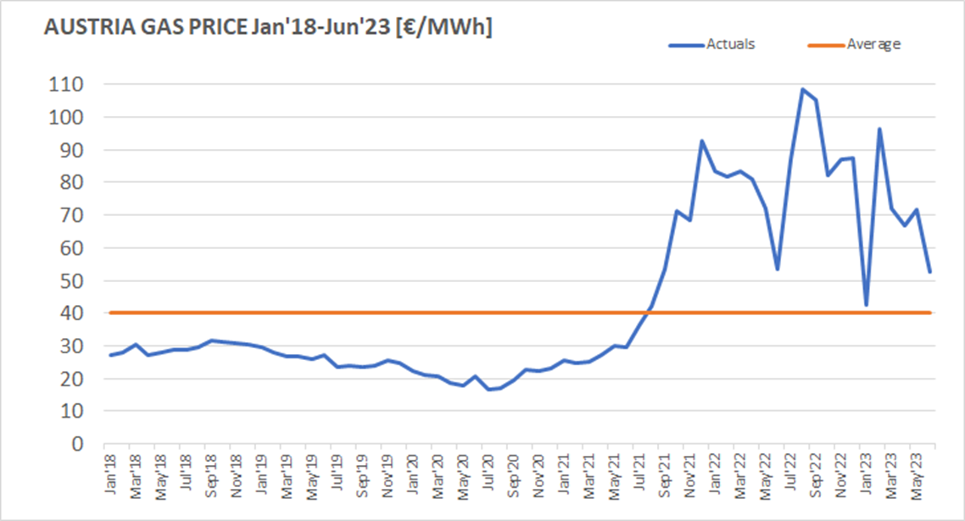
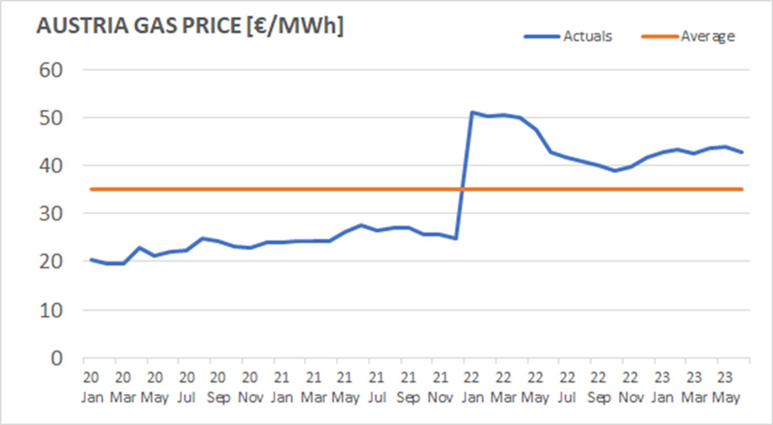
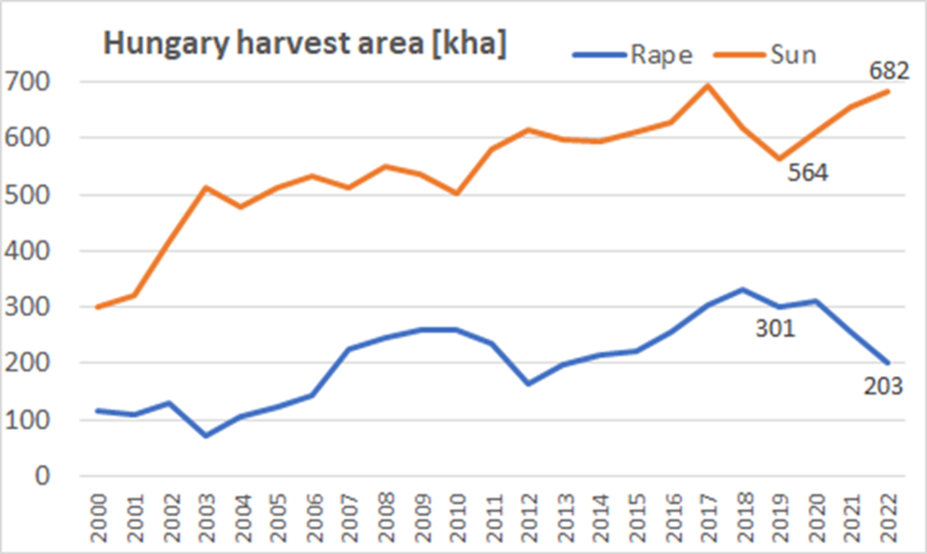
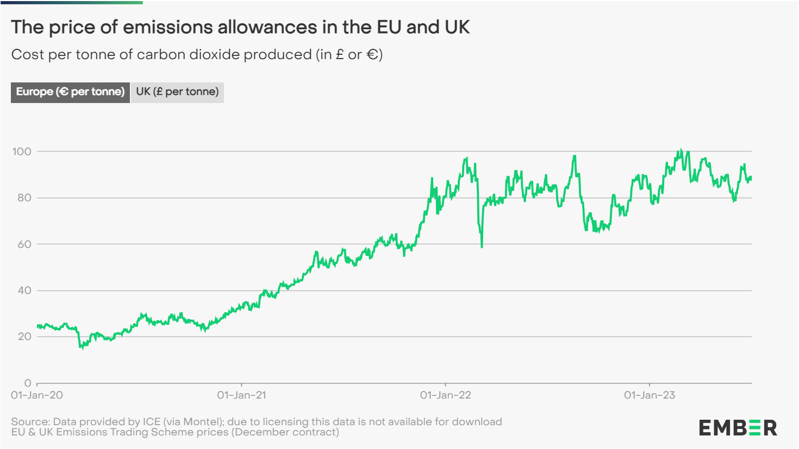
Consider Financial Risks & Trends
Project Sensitivity Analysis
32

Slide 33
Legal Aspects
EHS & Food Safety; Fire Protection; Process Safety Management; State & Corporate
Increase total crush capacity by 16%, from 400 kMT to 473 kMT/a
Permit from authorities for plant volumes allowed
Run the process for “UVP-Feststellungsbescheid”
ONE permit for all planned project activities: capacity, boiler and refinery
Impact in environmental e.g. traffic, smell, noise, fumes, water, animals walfare
Legal support by experienced Legal Partner
SME support for coordination

Slide 34
Project Documentation Requirements

Slide 35
Projects Aspects worthy to Focus
Chosen Practices increasing Value in the Organisation

Slide 36
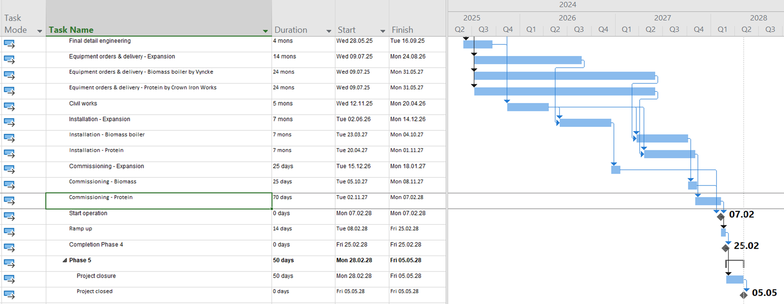
Project Discipline is a Must
Monitor Progress : Tailor existing unlimited options …

Slide 37
In case something goes wrong
Escalate Issues Transparently : Project One Pager Tool
Project Charter number: X1234
Title of the Project: Office Refurbishment
Overall Project Status:
Budget: Timing:
Current Status: The Office was built in 1973 and in the last 25 years the building condition worn out and business continuity risk for electricity blackouts. The heating and air treatment requires improvement. Canteen solution and associates well being is our priority.
Project Scope: The objective and the scope of the project is to cover and provide technical solutions for building refurbishment by removing redundunt wall structure, repairing the cealing leakages, provide brand new wireing for electric supply and also a heating air treatment ventillations.
Financial breakdown : Total requested budget is 876 kUSD
Phase 1 – we plan to refurbish first the 1st Floor by june 2023
Building refurbishment of 1st floor: 1234 kUSD
Electricity refurbishment: 567 kUSD
Phase 2 – refurbishment of grand floor from June – until Nov 2023.
Building refurbishment of grand floor: 123 kUSD
Electricity refurbishment: 678 kUSD
Phase 3 – New Project Request TBC – To be Confirmed after feasibility study
Escalation/Risk Management Proposal:
Risk: The original 256 kUSD budget will not cover approved Phase 1 scope due to
Inflation – 23% resulting 45 kUSD extra cost
Technical scope change: 23 kUSD additional cost
Recommendation:
The expected 68 kUSD extra cost will be covered by the re-allocation of Site CAPEX budget as there is a risk of underspending the approved budget by …. kUSD
Phase 2 and Phase 3 will be a New Project Submission by end of May.
Budget Status: The office refurbisment budget was approved at 256 kUSD
Project completion status: 56%
Spent Budget: 100%
Open PO: 0
Available to spend: 0
Timing: if the requested extra budget allocation is approved, execution Timing is OK.

Slide 38
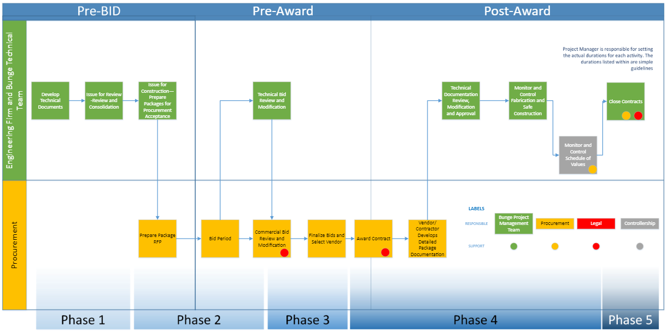
Responsibilities Clarity increases Process Efficiency
Procurement & Engineering Flow Diagram
STEPS TO BE READY BEFORE PROJECT APPROVAL

Slide 39
Decrease Risk of Project Failure or Delay
Rigid & Objective Vendors Assesment

Slide 40
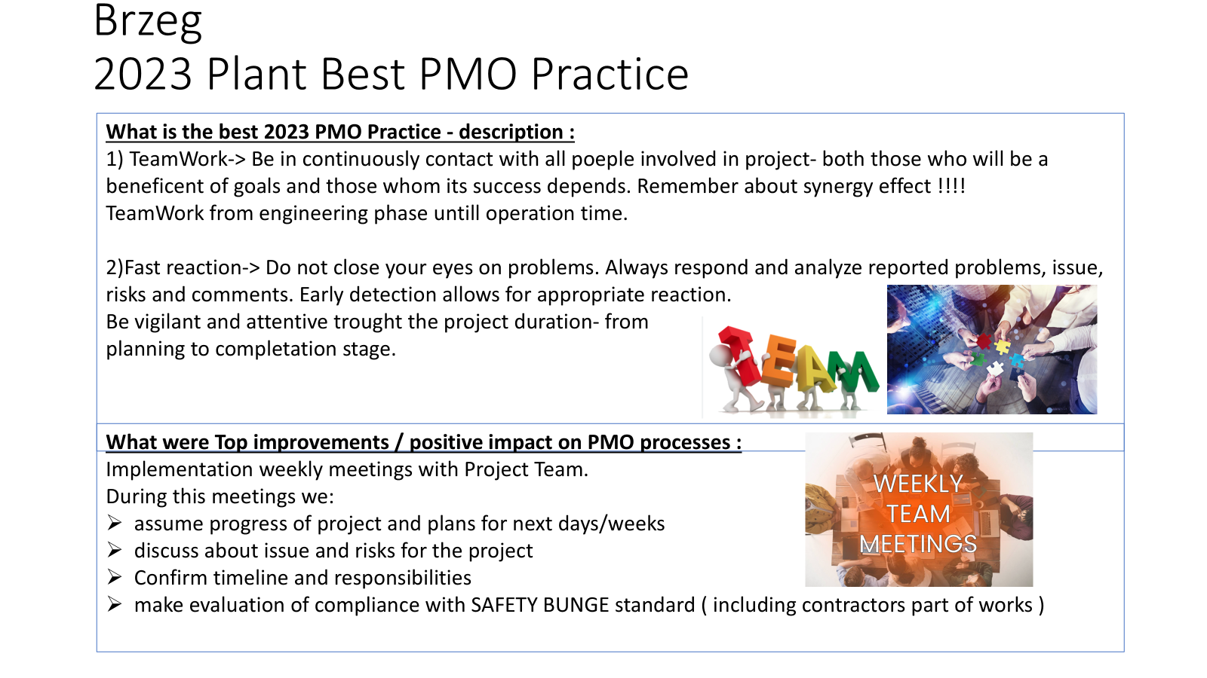
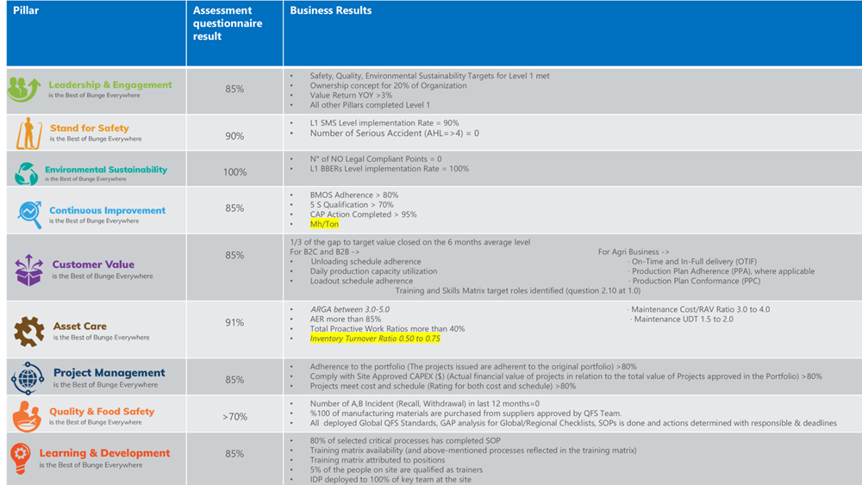
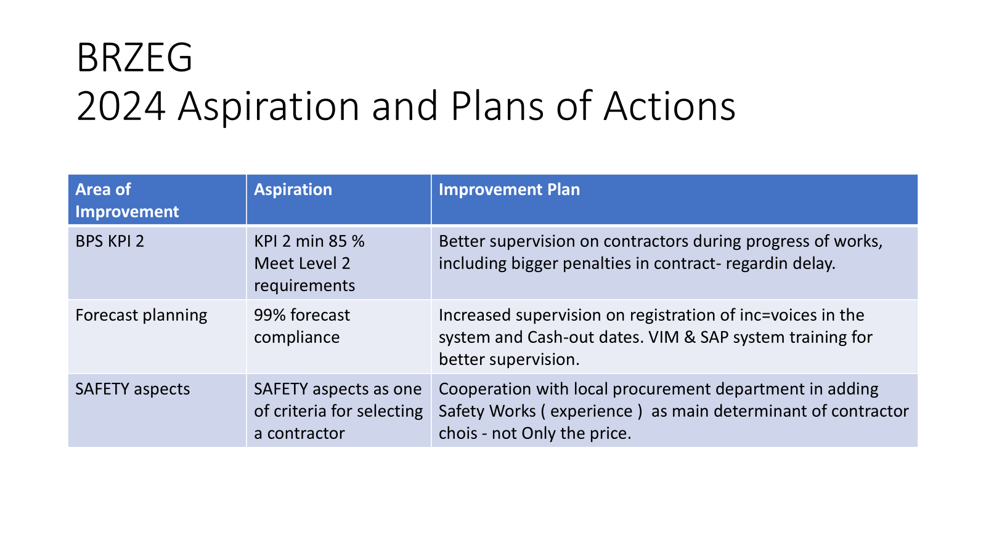
Operations Team One Focus
Projects included in Continuous Improvement Process

Slide 41
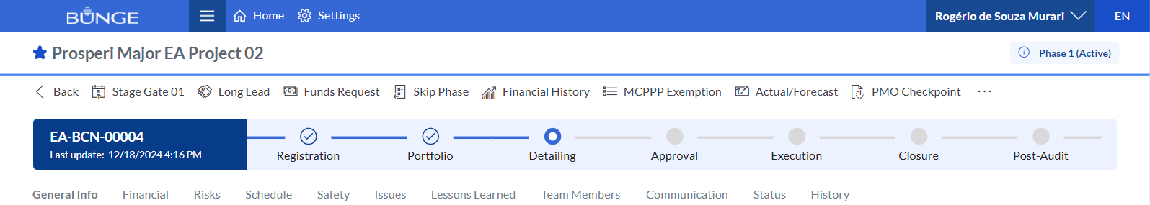
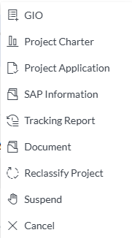
Support with PPM Project Planning Management System
Project Sections
General Info
Financial plan
Risks
Schedule
Safety
Issues
Lessons Learned
Team Members
Communication Plan
Project Status
Major toolbar
Stage Gate
Long Lead
Fund Request
Skip Phase
MCPPP Exemption
Import Actual / Forecast
GIO
Project Charter
Project Application
SAP Information
Tracking Report
Project Documents
Reclassifiy Project
Sunspend / Cancel
Minor toolbar
Fund Request
Import Actual / Forecast
Project Charter
Project Application
SAP Information
Tracking Report
Project Documents
Reclassifiy Project
Sunspend / Cancel

Slide 42


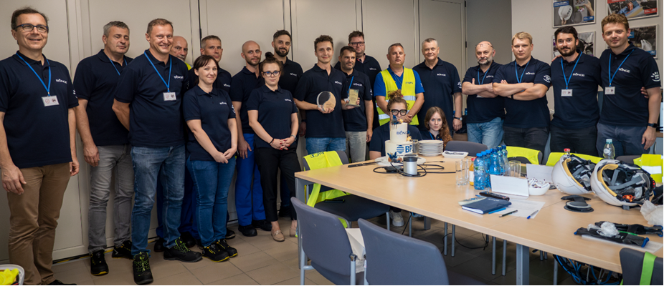
Finally Let´s Celebrate !
2025 Best Improvement Projects Award
Award 2 : Improvement of the meal moisture regulation process by using advanced process control – Brzeg Plant
Award 3 : Seeds silo cleaning automatization – Mikolaiv Plant
Award 1 : New device for precise measuring flakers rolls – Kruszwica Plant
Plants Bunge Production System Certification

Slide 43











All Results Thanks to our NCE PMO Team !!
BRZEG
Anna Ploskonka
Przemek Banik
BRUCK
Kourosh Esfandiari
Daniel Schwartz
Istvan Langer
NCE
Slawek Kluszczynski
KRUSZWICA
Aleksandra Lewandowska
Adrian Szymaniak
MANNHEIM
Kai Hanig
Neel Kumar
Rene Altmann-Hermann
DNIPRO & MIKOLAIV
David Stepanov
Konstiantin Khokhlov

Slide 44
Thank you
Dziękuję

